Slide 1
CEH-Mod 5- Vulnerability Analysis
Prof LaCava
Following the CEH v10 Curriculum
For Certification

Slide 2
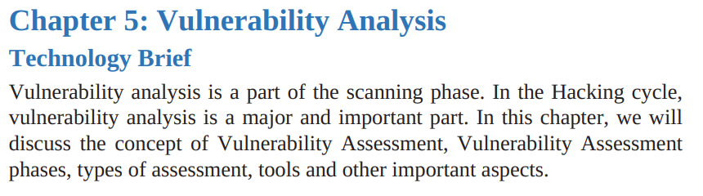

Slide 3
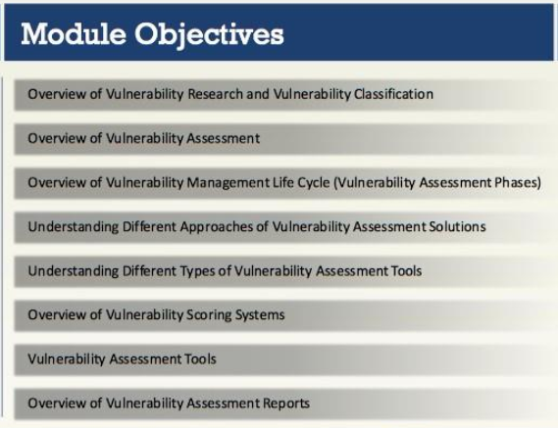

Slide 4
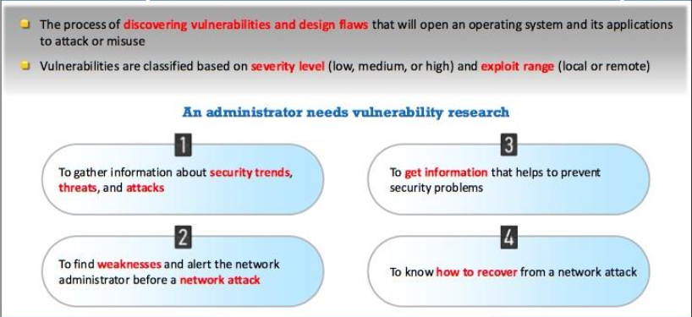
Vulnerability Research

Slide 5
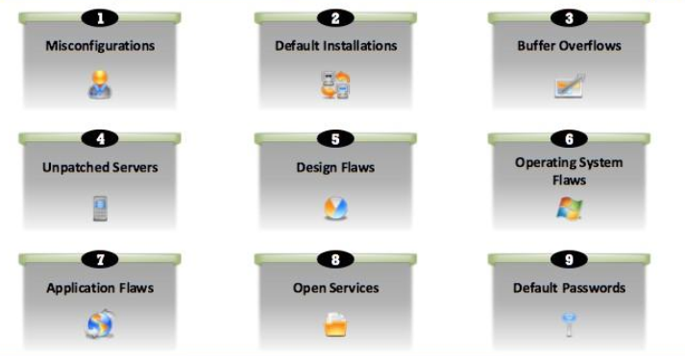
Vulnerability Classification

Slide 6
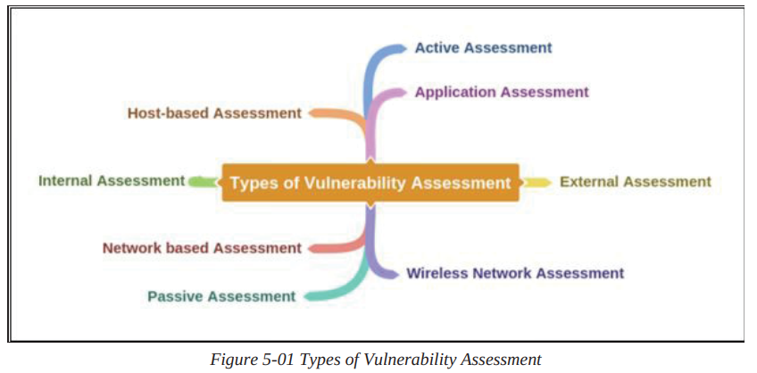

Slide 7
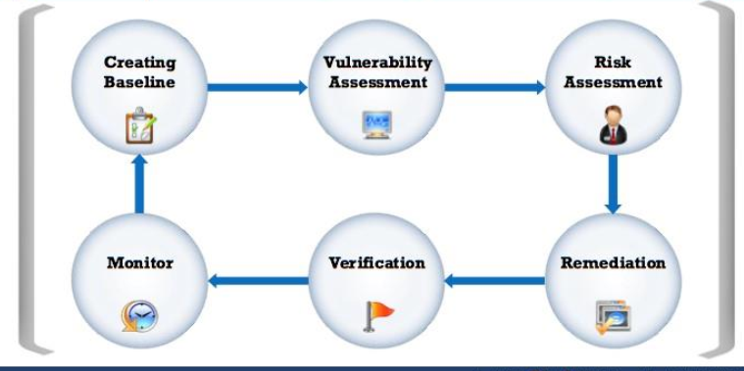
Vulnerability Assessment Life Cycle

Slide 8
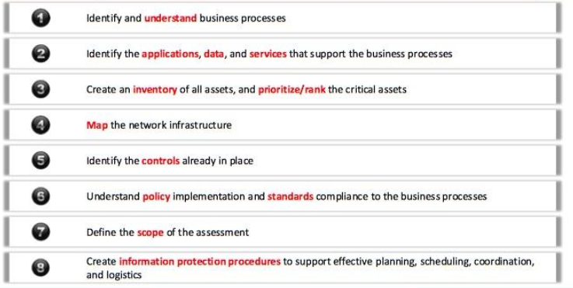
Pre-assessment and baseline creation

Slide 9
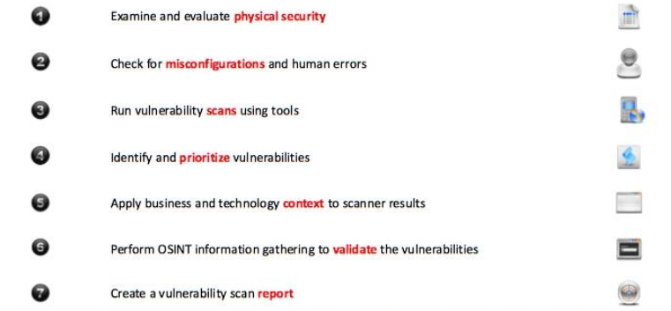
Vulnerability Assessment Phase

Slide 10
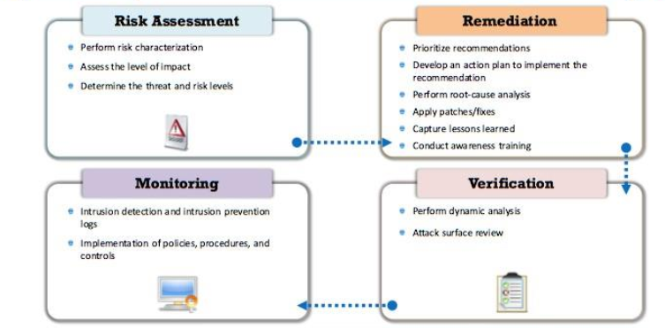
Post Assessment Phase

Slide 11
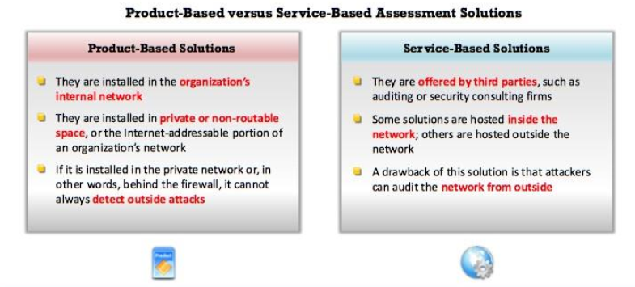
Approaches to Vulnerability Anal Solutions

Slide 12
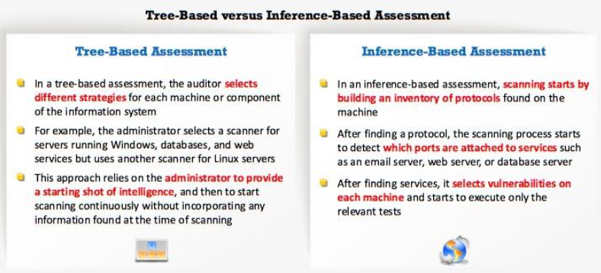
Other Approaches

Slide 13
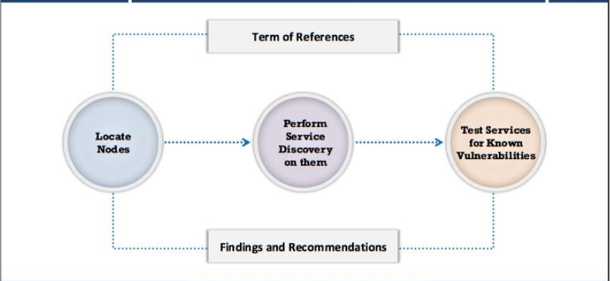
Vulnerability Scanning Working

Slide 14
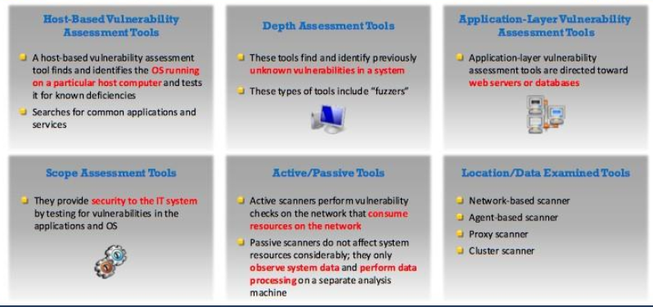
Types of Vulnerability Assessment Tools

Slide 15
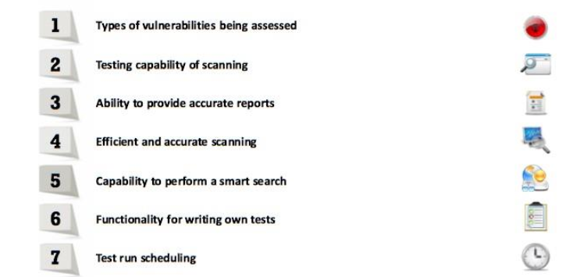
Criteria for choosing a Vulnerability Scanning Tool

Slide 16
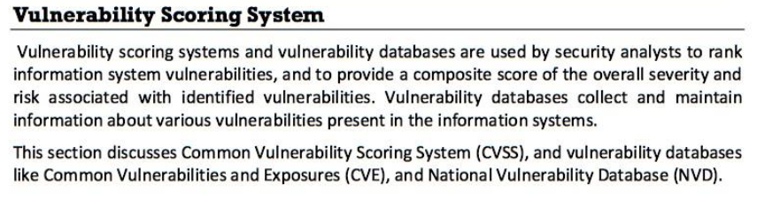
Vulnerability Scoring System

Slide 17
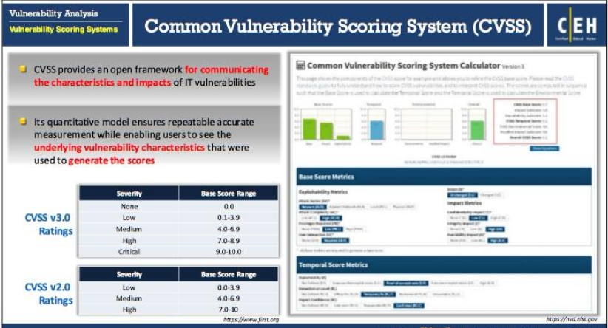
CVSS

Slide 18
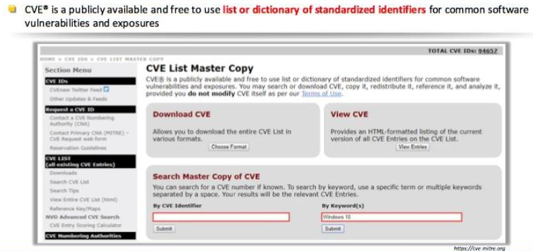
CVE (Common Vulnerability and Exposure)

Slide 19
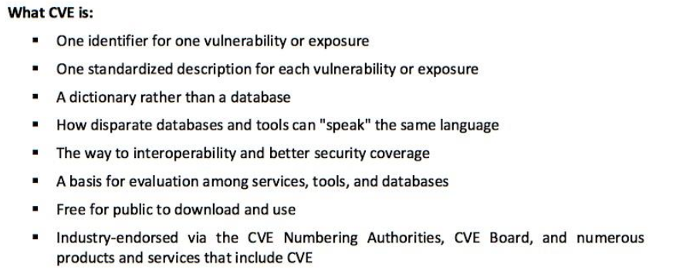
What CVE is

Slide 20
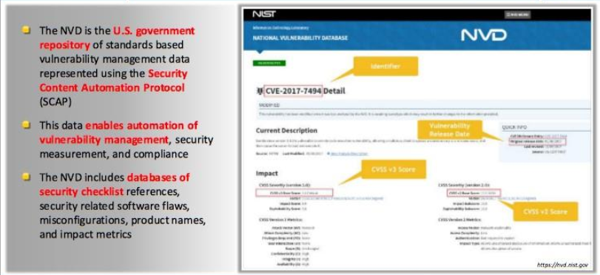

The National Vulnerability Database

Slide 21
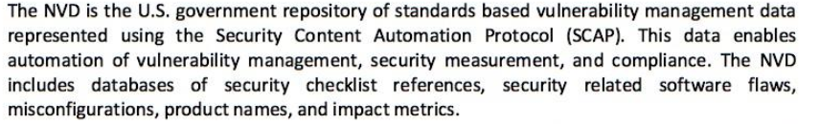
The NVD

Slide 22
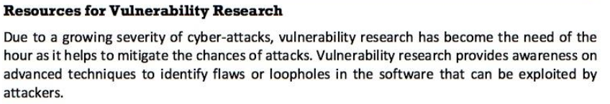
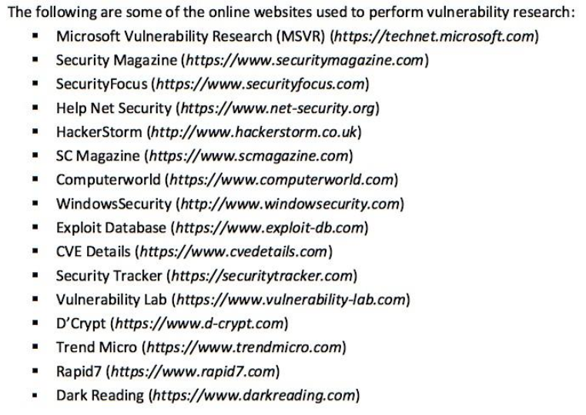
Resources for Vulnerability Research

Slide 23
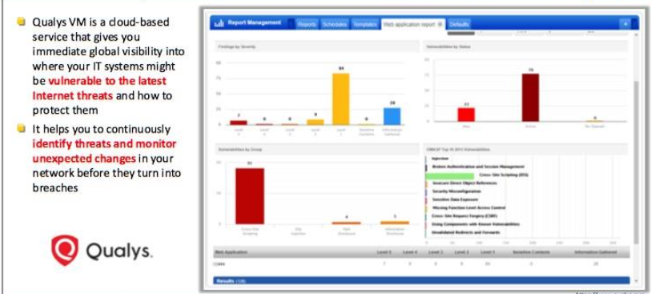
Vulnerability Assessment Tools Qualsys Vulnerability Manager
Agent-based detection
Constant monitoring and alerts
Comprehensive coverage and visibility
https://www.Qualsys.com

Slide 24
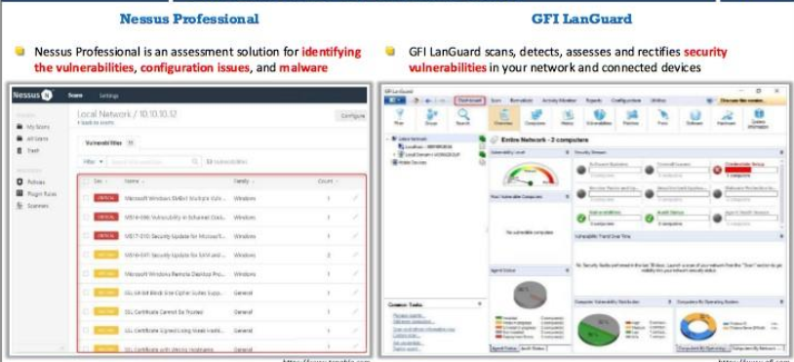
Vulnerability Analysis: Nessus and LanGuard

Slide 25
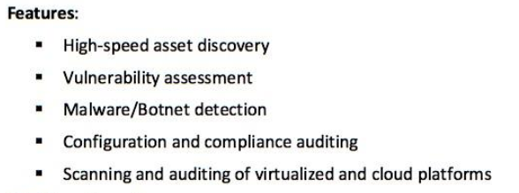
Nessus

Slide 26

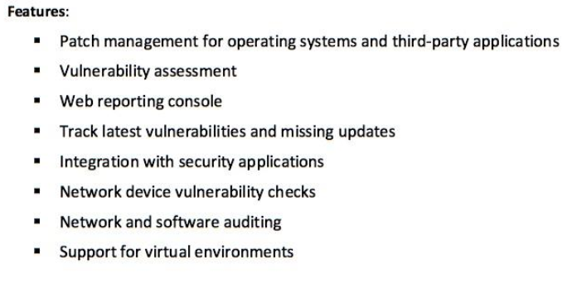
GFI-LanGuard

Slide 27
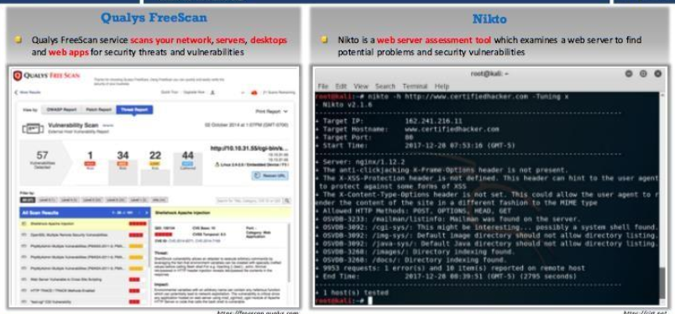
Qualsys Freescan and Nikto

Slide 28
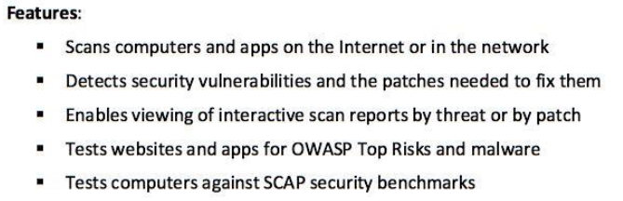
Qualsys Freescan

Slide 29
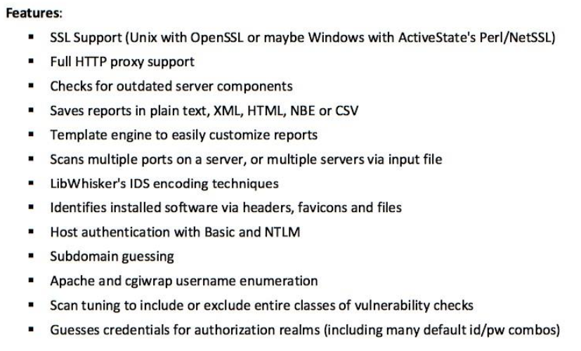
Nikto

Slide 30
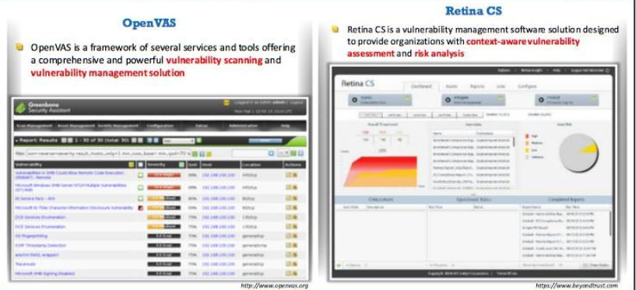
Open VAS and Retina CS

Slide 31
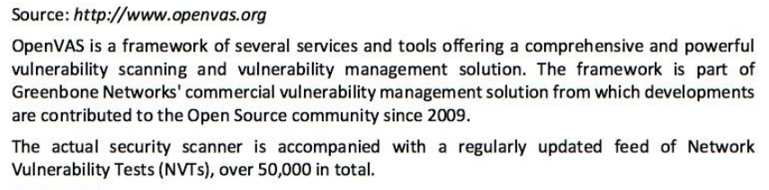
Open Vas

Slide 32
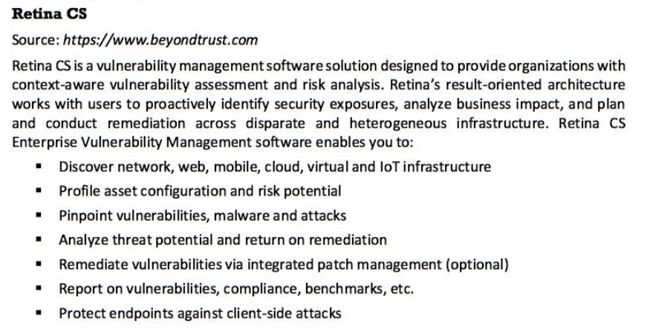
Retina CS

Slide 33
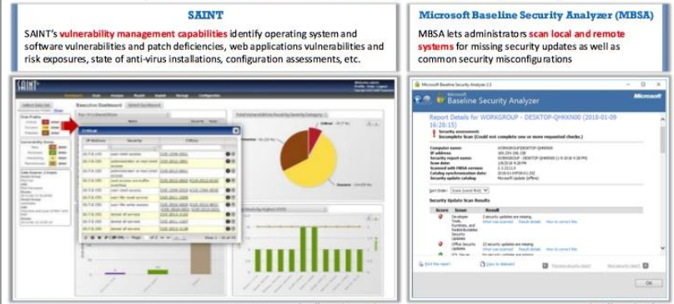

SAINT and Microsoft Baseline Security Analyzer

Slide 34
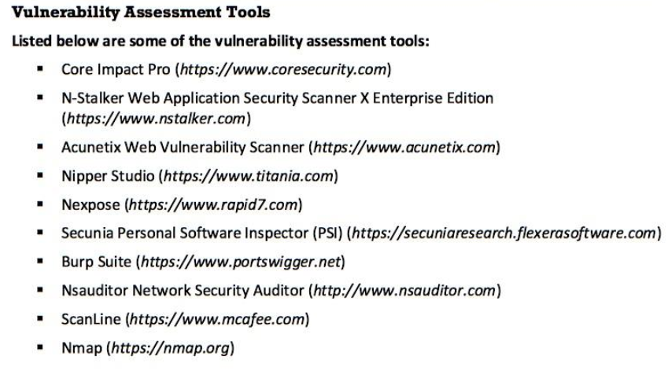
Other Vulnerability Assessment Tools

Slide 35
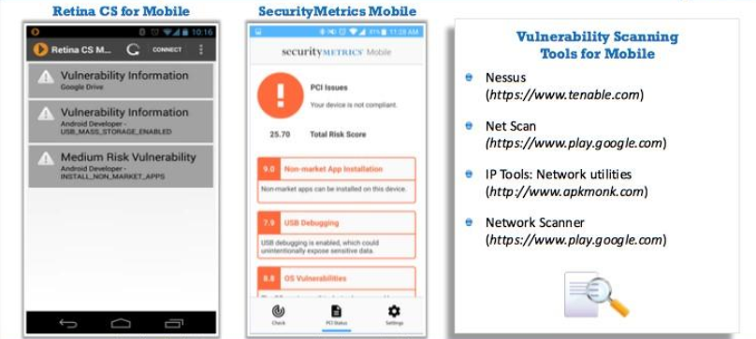
Vulnerability Assessment for Mobile

Slide 36
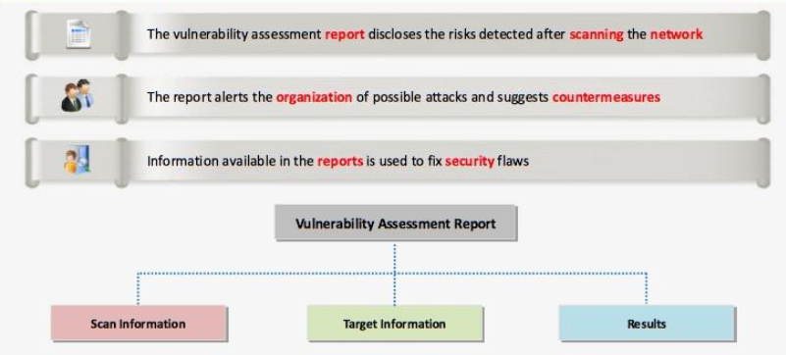
Vulnerability assessment reports

Slide 37
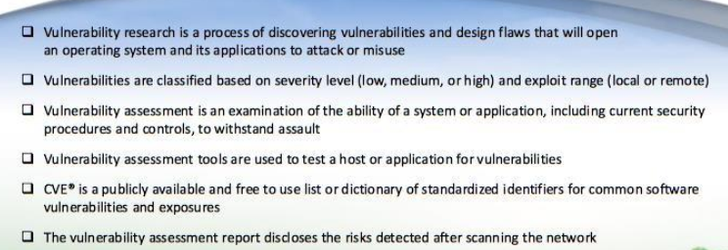
Summary

